Slide 1
Submitting Reflections Entries to NCPTA
Training for Councils and Local Units without Active Councils

Slide 2
Recommended Browser
For best results and to avoid difficulties with submitting Reflections entries, DO NOT use Google Chrome.
Please try Firefox or Safari

Slide 3
Start Preparing Early!
Confirm your Council/PTA is in Good Standing
Organize files ahead of time
Print and fill out Participation Form
Verify Student Entry Forms are complete
Convert Reflections art files to proper format
Double check the art files have the correct naming convention

Slide 4
Good Standing Reminder
Important: You will not be able to register or submit Reflections entries if your Council/PTA is not in Good Standing
Councils may only submit Reflections entries for PTAs in Good Standing

Slide 5
Steps to Success
Step 1: Start Preparing Early
Verify Good Standing
Preparation of Reflections Art Files and Participation Forms
Verify Student Entry Forms are complete
Step 2: Download and review submission instructions
Step 3: Register Reflections Chair
Step 4: Enter Participation Form
Step 5: Enter Student Entry Forms
Step 6: Upload Student Art Files
Step 7: Review “Completed Reflections Entries” list

Slide 6
Register Your Reflections Chair
The Reflections Chair who is responsible for submitting the Reflections entries must register
To register you will need to provide your name, email, phone number and password
The system will only allow for one registered user per Council/PTA
Once you register, you will use your email address and password to log into the system
NOTE that Reflections Chairs must create a new registration each school year

Slide 7
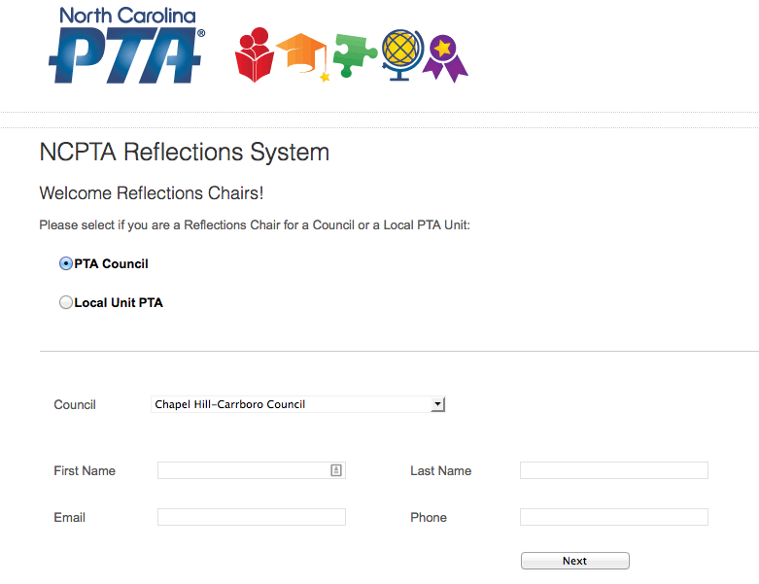
Register Screen Shot (Council)

Slide 8
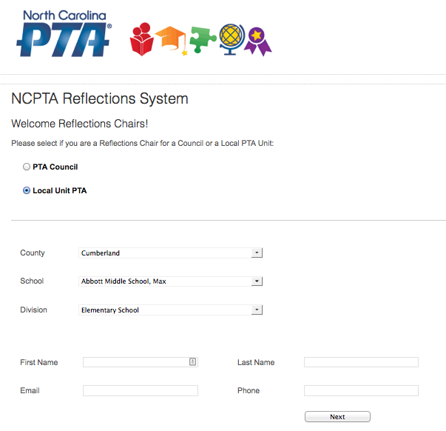
Register Screen Shot (PTA)

Slide 9
Participation Form
Enter the Participation Form information
This form must be entered in its entirety in order to submit Reflections entries

Slide 10
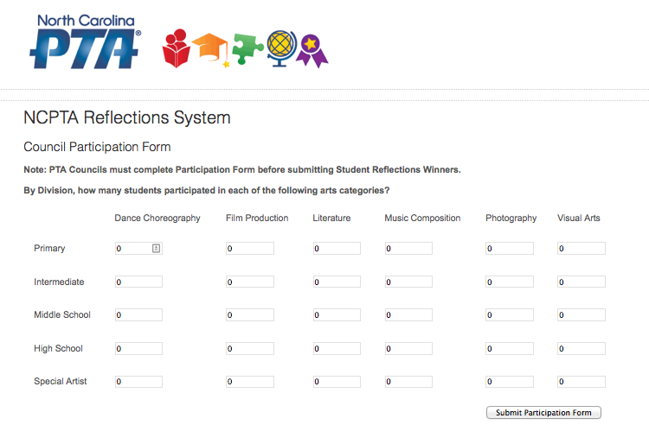
Participation Screen Shot

Slide 11
Submitting Reflections Entries
Submitting entries is a two-part process
Part 1: Enter the Student Entry Form
Part 2: Upload the Reflections Art File
You must enter the Student Entry Form first before uploading the Art File
You can either enter all the Student Entry Forms at one time and then upload all the art files, or, you may enter one complete submission at a time (Student Entry and Art File)

Slide 12
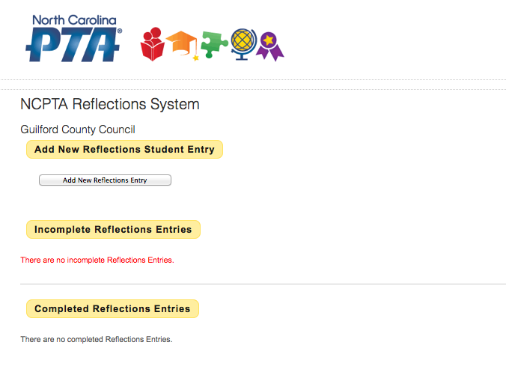
Screen Shot
Click to add new Student Entry Form

Slide 13
Student Entry Form
The Student Entry Form MUST be manually entered
The Student Entry Form must be completed in its entirety in order for the system to accept the entry
If the parent email address or phone is not provided, the chair will need to use their own
Once the Student Entry Form is complete, you will see the entry in the “Incomplete Reflections Entries” section. It is incomplete because the Reflections Art File must be uploaded
Note: The system will only allow one reflections entry for a student and category combination. If you have multiple entries for the same student (i.e. Sally Jones has two Music entries), enter the second name as “First Last2″ (i.e. Sally Jones2) in the student entry form

Slide 14
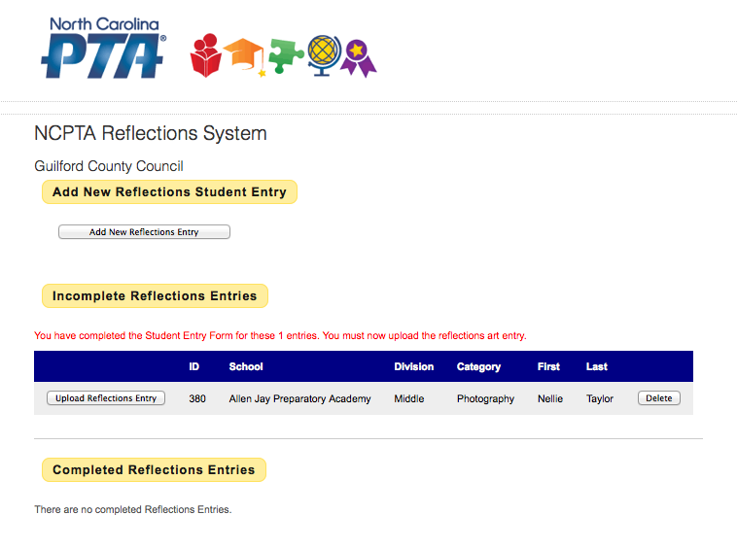
Screenshot - Incomplete

Slide 15
Upload Reflections Art File
Browse and select the appropriate Reflections Art File from your computer and click the “Upload Entry” button
The acceptable electronic formats for file submission are:
Dance: AVI or MP4. File size must not exceed 200 MB. Video must not exceed 5 minutes in length
Film: AVI or MP4. File size must not exceed 200 MB. Video must not exceed 5 minutes in length
Literature: PDF file size can not exceed 3MB. Entries must be scanned PDF files or a Word file saved as a PDF file. Do not take a photograph of the literature entry
Music: MP3 and file size must not exceed 200 MB. Video must not exceed 5 minutes in length. Scores are required for middle and high school divisions. Score must be scanned PDF file. Do not take a photograph of the score
Photography: JPG, JPEG, or PNG . File size can not exceed 3 MB
Visual Arts: JPG, JPEG, or PNG. File size can not exceed 3 MB
3D entries must submit 3 JPEG from varying angles

Slide 16
Required Naming Convention
How to name the arts file when submitting a student’s entry
Required Abbreviations for Categories:
Dance-Dance
Film-Film
Literature-Lit
Music- Music
Photography-Photo
Visual Arts- VA
Required abbreviations for Divisions:
Primary- Pri
Intermediate- Int
Middle- Mid
High- High
Special Artist- SA

Slide 17
Naming Convention, Cont’d.
This applies to Dance, Film, Literature, Music, Photography, and 2D Visual Arts Submissions:
Single Entry:
Category-Division-Last-First
Example: Dance-Pri-Smith-Sally
Multiple Entries for the same student (submission of more than one entry in a category):
Category-Divison-Last2-First
Category-Divison-Last3-First
Example: Dance-Pri-Smith2-Sally
Dance-Pri-Smith3-Sally

Slide 18
Naming Convention, Cont’d.
How to name music scores:
Music-Divison-last-first.PDF
* The system will only allow one Reflections entry for a student and category combination. If you have multiple entries for the same student (i.e. Sally Jones has two Music entries), enter the second name as “First Last2″ (i.e. Sally Jones2) in the student entry form.

Slide 19
3D Visual Arts Submissions
All 3D Visual Arts entries are required to submit 3 photos of varying angles
Single Submissions:
VA-Division-Last-First-1
VA-Division-Last-First-2
VA-Division-Last-First-3
Example:
VA-Int-Jones-Tom-1
VA-Int-Jones-Tom-2
VA-Int-Jones-Tom-3
Multiple Entries for the same student
VA-Division-Last2-First-1
VA-Division-Last2-First-2
VA-Division-Last2-First-3
Example:
VA-Int-Jones2-Tom-1
VA-Int-Jones2-Tom-2
VA-Int-Jones2-Tom-3

Slide 20
Entry File Tips
Taking too long to upload?
When uploading film and dance entries, please be patient. Larger files require more time to upload into the system.
Do you have two PDF files that need to be in one PDF document?
Combine multiple PDF files into one PDF file: http://www.pdfmerge.com/
Is your PDF file too big?
Reduce the size of a PDF file that is too large: http://createpdf.neevia.com/pdfcompress/
Is your entry file in the wrong file format?
File conversion: http://www.zamzar.com/

Slide 21
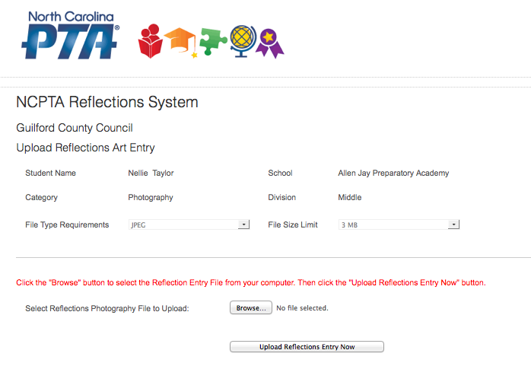
Screenshot - Upload
Click to select Reflections Art File from your computer

Slide 22
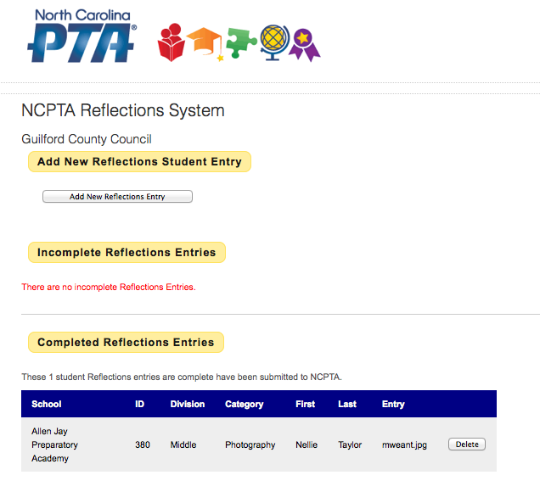
Screenshot - Complete

Slide 23
Review Entries for Accuracy
Once you have entered the Student Entry Form and uploaded the Art File, the student will be listed under “Completed Reflections Entries”
The entries in this list have been submitted to NCPTA and no further action is needed
The Submission Process is not complete until both the Student Entry Form is entered and the Art File is uploaded
Option to Delete a Submission
Once the Student Entry Form is entered and the Student Art File is uploaded, modifications can not be made but the user can delete the entry and start over

Slide 24
Wrap Up
Remember to start early and take time to prepare!
Deadline to submit entries into the NCPTA Reflections Submission Website is Wednesday, January 6, 2021
No changes or modifications after January 6
If an entry is not complete by January 6, the submission will be disqualified
Detailed Instructions on the NCPTA Website
Contact the NCPTA Office with any questions
Thank you for volunteering!

